Slide 1
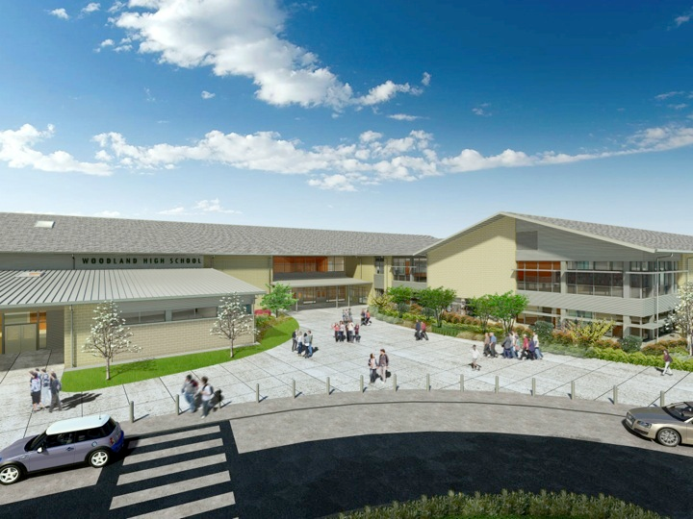
Woodland Public Schools
Facilities and Safety
May 2017 Report

Slide 2
FACILITIES REPORT
WIS Portables
Portables will be delivered Monday and Tuesday 6/26 & 6/27. It will take approximately 4 days to join, level connect the buildings. This week we are getting all of the plumbing under the buildings completed and have started the rough in for main electrical and fire/data and simplex. After the buildings are in, it will talk another 3 weeks to complete the low voltage runs, terminate plumbing, install carpeting, ramps and stairs. When the facilitation is complete and all systems are tested, then its time to add furniture and kids! Shooting for occupancy permit the week of 7 August.
Roofing Options
I have been working with a supplier from GE silicones division that provides a roll on roof coating. Depending on the film thickness they will provide a 10, 15 or 20 year guarantee. This may be a great option for some of our roofs that are fatigued but the roof decking and framing beneath are in good shape. I have asked for a sample of this product to test.
LED lighting Update
Meet with Rob Salberg from Cowlitz PUD regarding the LED project. We can do this project in house and get reimbursed for our own labor to install. The cost for the bulbs is almost identical to the incentive of $3220 so the ROI on this project will be immediate.

Slide 3
Facilities Report Continued
Card key access system
WPS, WMS and WIS are all on the card key access system, We are now moving toward rekeying of the exterior doors. We are trying to complete this work with staff resources to cut cost. We have cores prepped for the WMS campus, then we will prep cores for balance of the schools.
Contractor Handbook
I have struggled a bit with some of our contractors not following basic OSHA safety rules and protocols for work at the schools. There are also additional safety rules that need to be followed due to the children being present. This summer I will create a procedure that details the requirements for contractors working on school property. All contractors performing work at the schools will have to sign and acknowledge that they understand these rules before performing work. This will help protect the students from injury and help limit our liability due to contractors being injured on school property.
Looking forward
My team and I are focused on completing a challenging amount of work over the summer period and are looking forward to starting the next school year with the school finely tuned for the success of our students and staff. In addition to the work, an equal amount of emphasis is being placed on employee development and training this summer. We are kicking off the summer with a training topic on cleaning chemistries and cleaning techniques facilitated by Walter E Nelson. Additionally we will continue to strengthen our occupational health and safety and safety programs.
Looking forward to the next school year, only 84 DAYS TO GO!

Slide 4
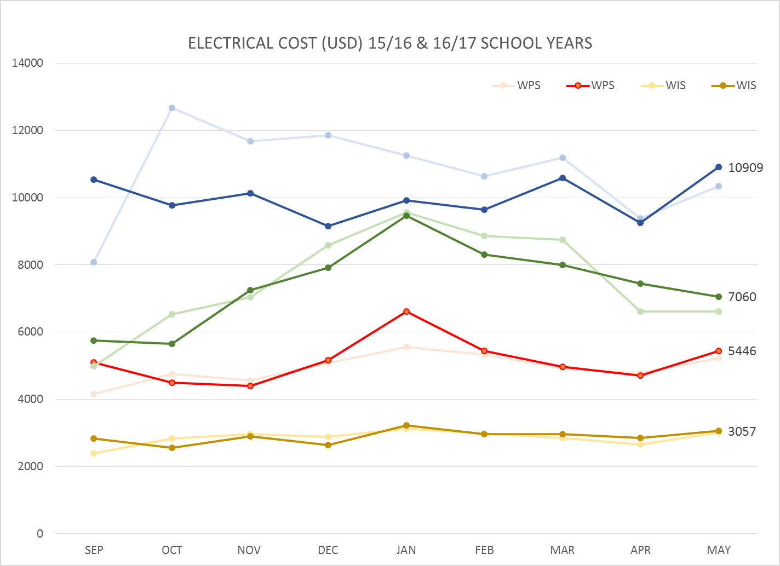
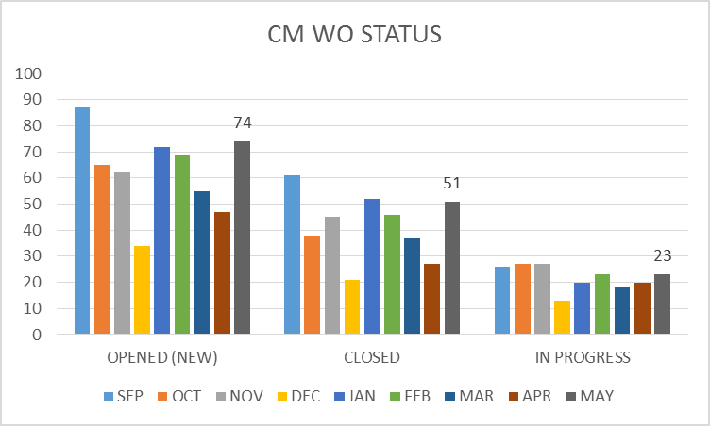
FACILITY CHARTS – POWER COST AND WORK ORDER STATUS
Electrical cost up slightly due to 32 day billing period and running chiller in manual at WHS due to PLC failure.
WMS cost is also elevated, investigating this.

Slide 5
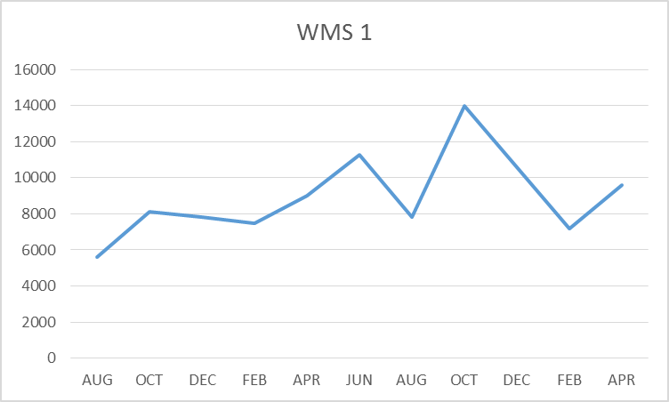
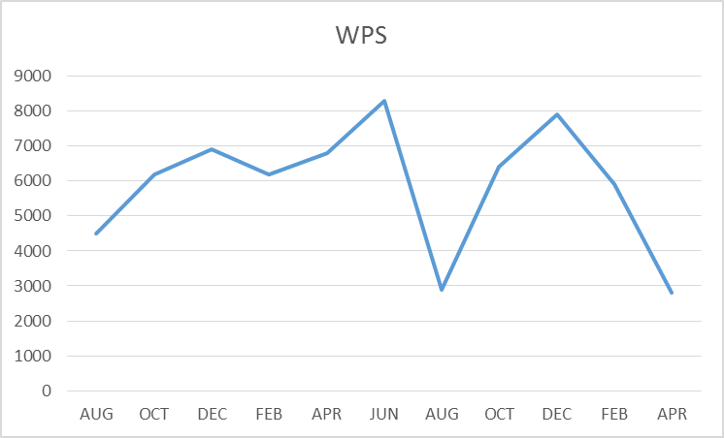
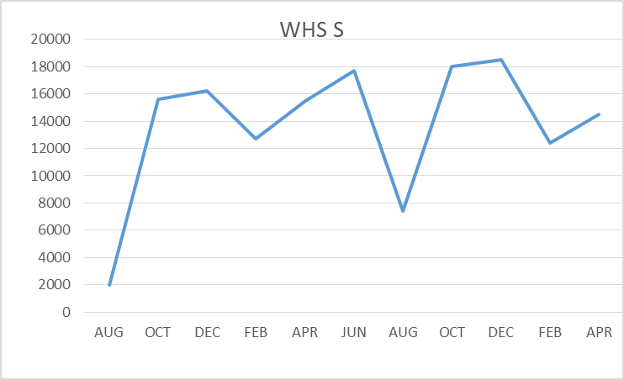
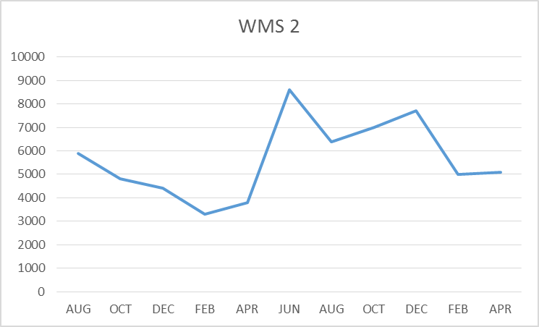
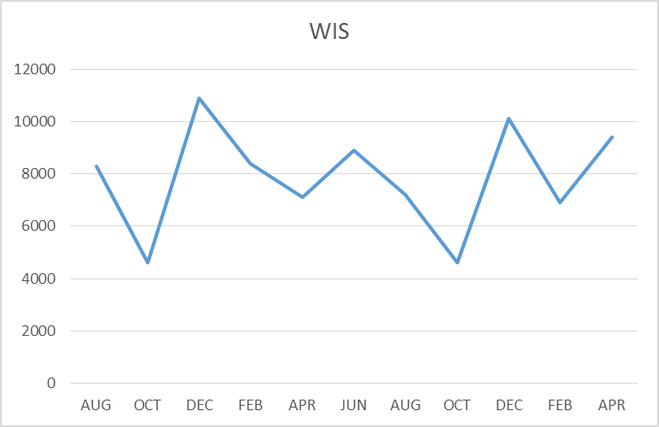
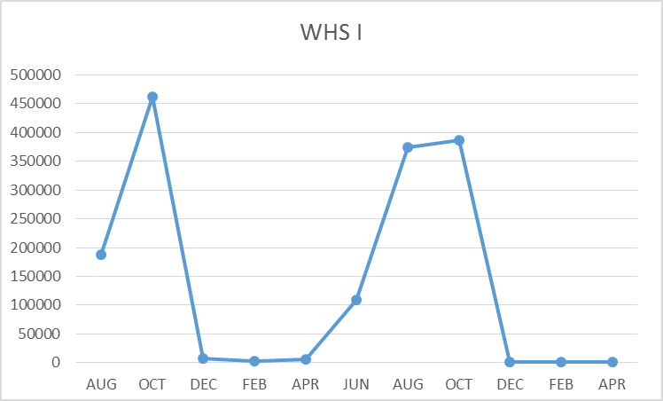
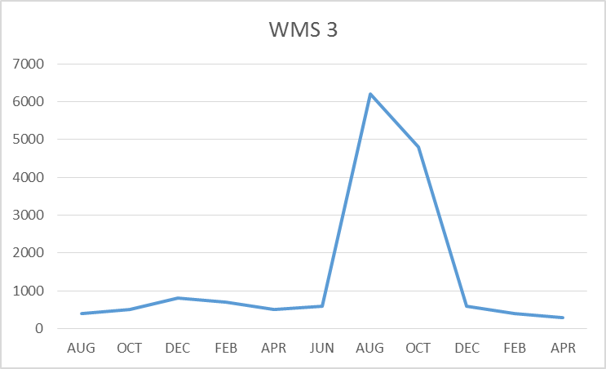
FACILITY CHARTS –
WATER USAGE
WHS, WIS, WMS, WPS
Water charts are updated every two
Months, next update to these charts
in July

Slide 6
SAFETY Report
Accidents for the month
There were a total of 7 injuries/incidents in the month, 4 student, 3 Staff
Staff Accidents/Incidents (3)
WPS – Employee hit knees on floor when she misjudged steps and fell
WPS – Employee tore muscle when pushing student on swing
WPS – Employee strained back while working on ramps for portable building
Student Accidents/injuries (4)
WPS – Student jumped to grab glider, misjudged distance, fell and broke arm
WHS – Student rolled ankle when retrieving a ball fracturing her fibula
WHS - Student collided with two others on soccer field, fractured collar bone
WHS – Football hit students head, sent to doctor as precautionary action (suspected concussion)
On a bright note, WPS has made huge leaps reducing and nearly eliminating employee injuries as the result of student behavioral issues. The numbers are quite impressive from a high 21 events in November thru January to 1 event over the last two months. This success is attributed to an effective deployment of a Student Behavior Management System deployed by Ingrid and her team at WPS…WELL DONE!

Slide 7
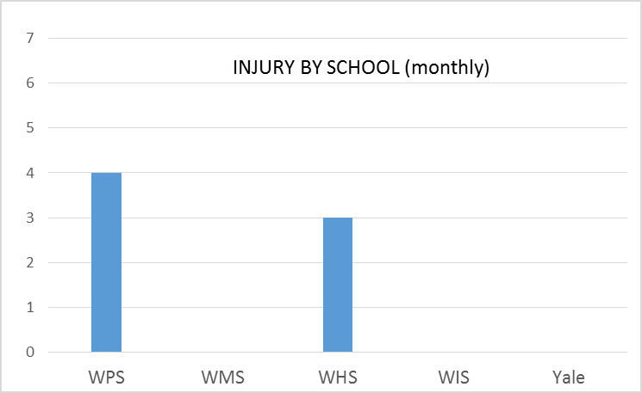
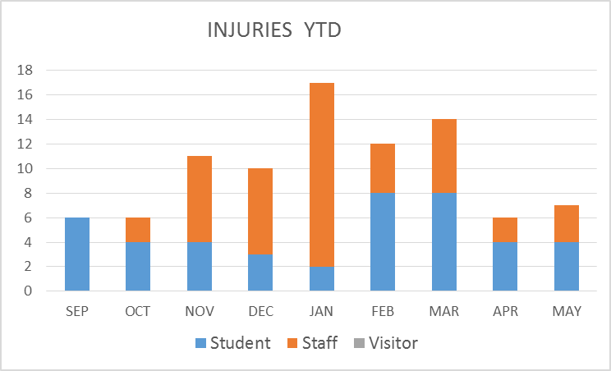
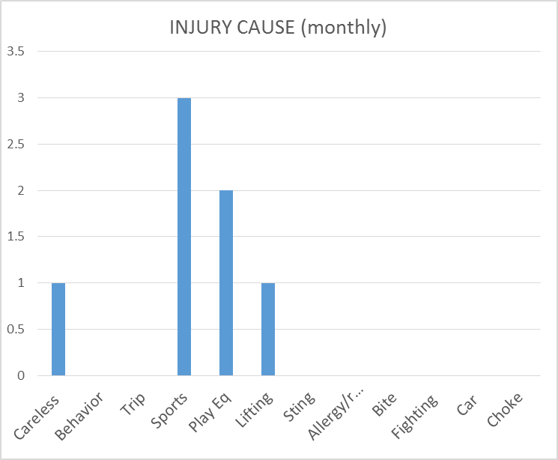
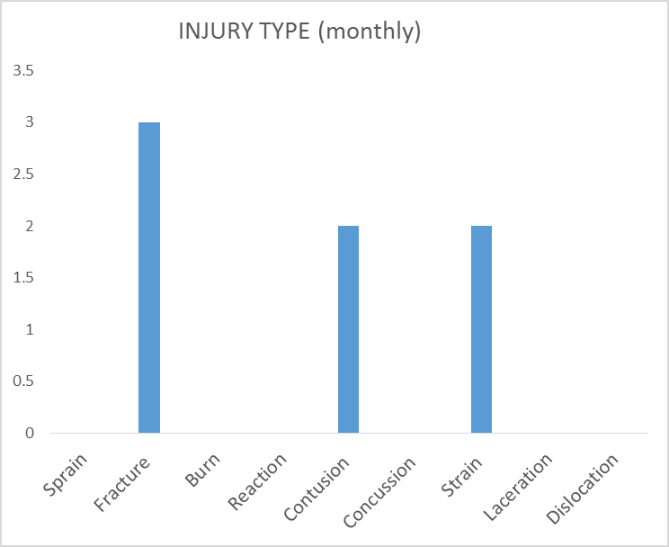
SAFETY CHARTS

Slide 8
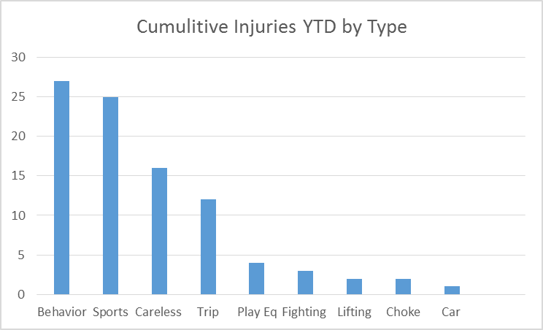
ANNUAL SUMMARY 16-17
There were a total of 92 student and staff injuries in the 16-17 school year (excluding June). The majority of the injuries
were minor in nature resulting in minor cuts and bruises. There were a handful of more serious injuries that resulted
in fractures and other types of injuries. Each injury regardless of the seriousness was investigated and corrective actions
put in place when necessary.
Annual Summary (Responses to top 5 Categories)
Injury cause | # of Events | Action taken
Behavior | 27 | WPS implemented Student Behavior Management System
Sports | 25 | Adequate follow up completed by athletics department for all sports related injuries
Careless | 16 | Enhanced problem areas with high visibility tape, removed potentially hazardous items
Trip/slip/fall | 12 | Emails sent to staff, anti slip carpets/ mats installed
Playground Equipment | 4 | Monthly check sheet and Preventive maintenance procedures created

